Slide 1


Guide to Referencing for Academic Integrity
To be read with reference to Doc 099 ‘MCAST Academic Integrity Policy and Procedure’ https://www.mcast.edu.mt/college-documents/
Authored by Dr Conrad Aquilina, Ms Charla Pia Vassallo, Ms Jacqueline Micallef Grimaud, Ozlem Basman Barillaro
Published : September 2022
Updated: May 2025

Slide 2
There are various reference styles.
The choice of referencing style is dictated by the institute wherein you are conducting your research studies.
These are indicated in the appendices to Doc 099 ‘MCAST Academic Integrity Policy and Procedure’ https://www.mcast.edu.mt/college-documents/.
Reference Styles
Notes:
- Montserrat or Verdana fonts
- 2 Options for Intro Slide

Slide 3
Why do we reference information?
When do we reference information?
How do we refer to information?
Why, When and How?
Notes:
- Montserrat or Verdana fonts
- 2 Options for Intro Slide

Slide 4
Why do we use referencing? (rationale)
In your studies, you will frequently need to access and use data and information that lies outside your knowledge base (what you already know).
You will be asked to provide examples, make use of other people’s theories or opinions, use concepts or statistical data, and include audio-visual or graphical material in your work.
While this material is not yours, if used appropriately, it will render your writing and organisation of content suitably academic and strong.
Finally, referencing is an expected convention found in all higher education institutions and programmes.

Slide 5
Why do we use referencing? (more practical reasons)
It immediately allows your readers to see which ideas and information are your own and which belong to other authors (through in-text citations, a short form of referencing).
It therefore recognises these authors as the source of that information (thereby reducing the risk of plagiarism).
It allows readers to identify and locate these sources, should they wish to make use of them (through a reference list, a more detailed way of displaying sources at the end of your document).
Gives breadth (more informative and specialised) and weight (more factual and scientific) to your work.
Allows readers to verify your data, making it more reliable.

Slide 6
When do we use referencing? (key indicators)
Should I reference information which is considered common knowledge?
General (‘The universe contains billions of galaxies.’)
Specific to my field (‘HVAC units are used to heat, ventilate and air condition buildings’.)
NO
Should I reference information which I directly quoted from a published source (i.e., it is available on a medium, e.g., book, journal, internet etc.)
‘Euclid defined a straight line as “that which lies evenly between its points” (Webb, 1974).’
YES
Should I reference information which I indirectly quoted or summarised from a published source, no matter how different it looks now?
‘In a Profession Survey of 1997, slightly less than half (45.6%) of the 2000 participants indicated having hands-on experience with monitoring the quality of air indoors and evaluating personal protective equipment (Association Research, 1997 as cited in National Academy Press, 2000).’
YES
Should I reference content in the form of statistics, diagrams, charts, images, etc., freely available online and/or when the author’s name is unknown?
YES

Slide 7
When do we use referencing? (key indicators)
Referencing the Use of Artificial Intelligence (AI)
AI used as a TOOL - NO
Referencing is not required when AI tools are used only to support the development of ideas or writing
Examples;
• Brainstorming ideas for a topic
• Improving grammar or language clarity
• Asking AI to explain a concept for study
• Structuring an outline or draft
• Generating practice questions for revision
AI used as DIRECT CONTENT - YES
AI outputs must be referenced when AI is used to generate material which is then used directly within the academic work.
Examples;
• Quoting AI-generated text
• Paraphrasing AI-generated explanations
• Using AI-generated definitions or explanations
• Including AI-generated code, images, or analysis
• Analysing or discussing AI output in the assignment

Slide 8
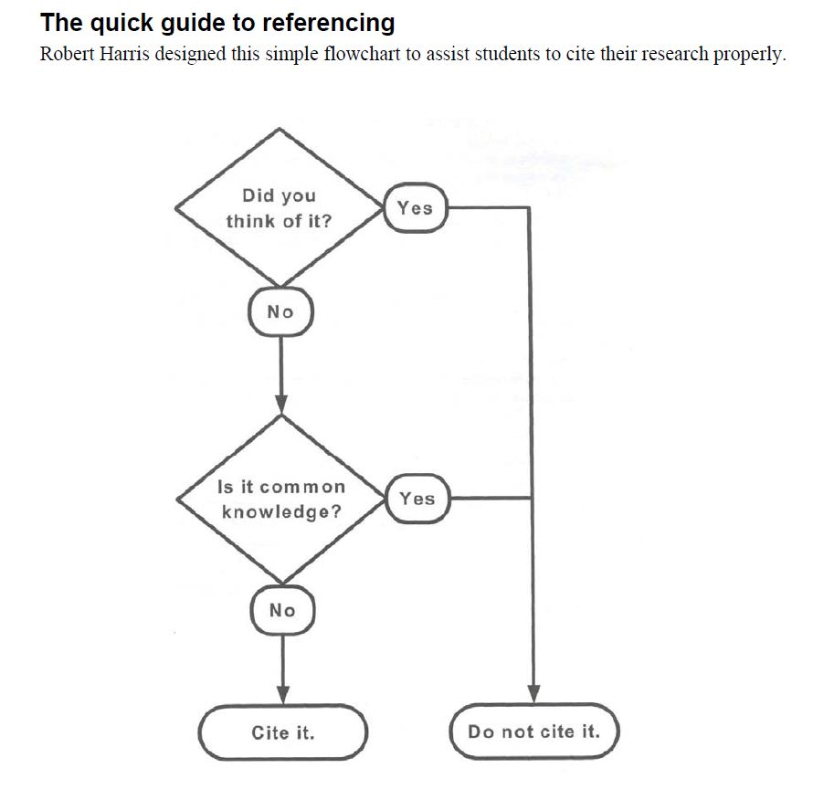
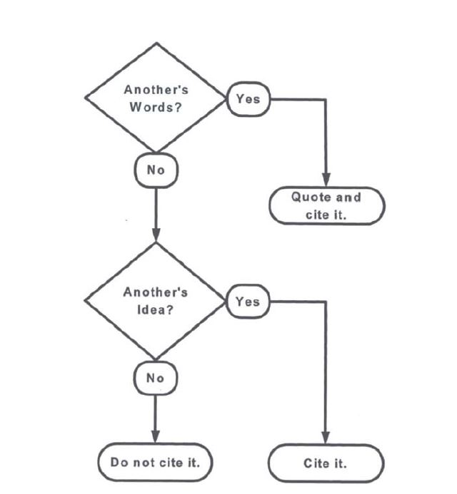
Harris, R 2001, The Plagiarism Handbook, Pyrczak Publishing, Los Angeles, CA, USA.

Slide 9
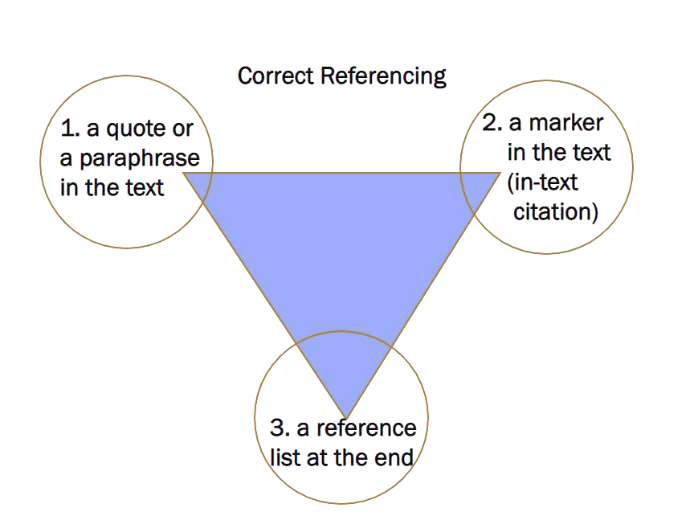
How do we refer to information?

Slide 10
What referencing looks like …
Direct quote
It is claimed that the government in the information age “works better and costs less” (Bellamy and Taylor 2005, p. 41). Moreover, as mentioned by Barker (2012), the internet facilitates information access and mobility by …
Indirect quote
In-text citations
References
Barker, D. (2012) Internet Research. Boston: Course Technology.
Bellamy, C. and Taylor, J.A. (2005) Governing in the Information Age, Buckingham, Open University Press.

Slide 11
Highlighting an author’s contribution or making the author the subject of the sentence.
In-text citations (various examples from Harvard, APA and IEEE)
Cowie (1996) suggests that unlike capitalism, socialism promotes the good of the many before individual good.
Defining the Internet of things as “simply the point in time when more ‘things or objects’ were connected to the Internet than people”, Cisco Systems estimated that the IoT was ‘born’ between 2008 and 2009 ^{[26]}.
Highlighting key information or ideas from a source (citing the author/s is secondary).
One study found that reading stories to children in which characters of different racial groups are present introduces them to a wider range of emotion learning opportunities (Grady et al., 2019).
Research on Alzheimer’s disease has shown that individuals as young as 18 displayed symptoms of the disease ^{[3], [5], [10], [12]}.
As a concept, Industry 4.0 aims to generate interest in smart factories with enhanced state-of-the-art technologies (Tan and Labastida, 2021). Driven by AI, automation, big data processing and the Internet of Things, Industry 4.0 will allow for greater flexibility, linking “traditional supply chain and production lines to new connected and flexible systems [which should] seamlessly connect the physical and digital worlds” (Nagpal et al., 2019, as cited in Tan and Labastida, 2021).

Slide 12

Source
Unacceptable Citation (some cases)
Understanding the athlete’s adaptation (e.g., performance level or health status) to the environment (e.g., weather, training, nutrition, or sleep), can be conceptually seen as the relationship between environment (e.g., training) and outcome (e.g., performance), but this, in many cases, is a rather complex and uncertain link, or what is called a black box (Fomin and Collins, 2022).
Poor paraphrasing
Fomin and Collins (2022) explain that understanding how athletes adapt to the environment (weather, nutrition, sleep) is rather complex and can be considered a black box since the relationship between training and performance is often quite uncertain.
Poor cut-and-paste practice
It can be difficult to understand an athlete’s adaptation (performance/health) to their environment as in many cases the link between training and its outcome is rather complex. In fact, Fomin and Collins (2022) refer to this uncertainty as “a black box”.
Near word-for-word plagiarism
An athlete’s adaptation (performance level or health status) to their environment can be seen, conceptually, as the link between training and outcome (or performance). More often than not, as Fomin and Collins (2022) observe, this link is complex, and it can be quite difficult to understand this black box.

Slide 13
The building blocks of a reference
Who is responsible?
Author details (individual/s or organisation)
What is the work called ?
Title of the book, article, webpage or other document
When?
Date of publication, last edit or access
Where and how can I find it ?
In a book (place and publisher)
In a journal (journal name, volume, issue and page numbers
Online (URL or DOI)

Slide 14

Book reference
You can find all the elements you need to reference on the book itself, on Library Search, or on the catalogue record, as shown in the next slides.

Slide 15
Elements of a book reference
Author
Maier, R.
The surname of the author comes first followed by a comma, a space and the initial(s) of the first name(s) of the author. In this case Ronald is abbreviated to R.
Year
(2007)
In the Harvard style, the year of publication is always surrounded by round brackets.
Title
Knowledge Management Systems: Information and Communication Technologies for Knowledge Management.
The book title is always in italics followed by a full stop
Edition (if not first)
Only include the edition if it is NOT the 1st edition
Publication
Springer Books: Note the (:) after the place of publication
Publisher
Springer, Berlin, Heidelberg.
Note the full stop after the publisher’s name/country of publication

Slide 16
Maier, R. (2007) Knowledge Management Systems: Information and Communication Technologies for Knowledge Management, 3rd Edition. Springer Books: Springer, Berlin, Heidelberg.
Book reference
Year of
Publication
Author
Title and Sub-title
Edition
(as not the 1st)
Publication
Publisher and Place of Publication

Slide 17
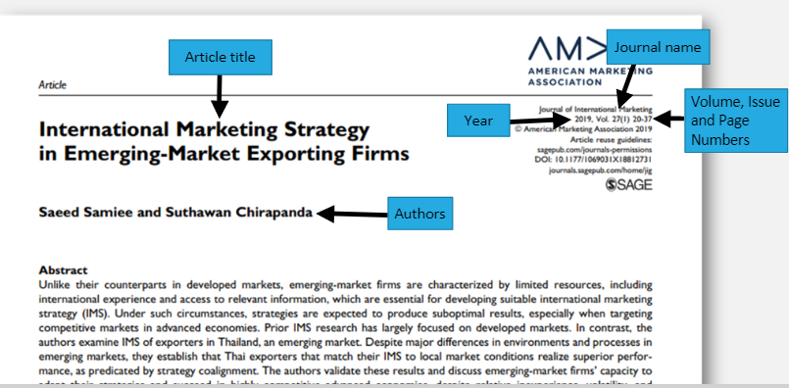
Elements of a journal article reference

Slide 18
Samiee, S. and Chirapanda, S (2019) ‘International marketing strategy in emerging-market exporting firms’, Journal of International Marketing, 27 (1), pp. 20-37.
Journal article reference
Authors
Date
Article Title
Journal Name
Volume , issue and
page numbers

Slide 19
Department for Business, Innovation and Skills (2011) UK research base most productive in the world. Available at: http://www.bis.gov.uk/news/topstories/2011/Oct/UK-research-base-most-productive -in-the-world (Accessed: 31 July 2020).
Website reference
Web pages often do not have named authors so you can use the name of the organisation responsible for the site if necessary
Author/s
Date
Title
URL
Date you viewed it
If you are unable to find a year, look for the date of last update or a copyright year at the bottom of the page

Slide 20
The basics of a Reference List entry for lecture notes:
Lecturer notes
Author or authors. The surname is followed by first initials.
Year
Title (in italics)
Description of format
Unit name and Unit code
University
Date lecture was delivered
Naughton, S 2018, Seminar 7: Transforming organisations: strategy, structure & design, lecture notes, Organisation Change Management BMO6624, Victoria University, delivered 21 May 2018.
Author
(if stated)
Title
Format
Year
Subject unit title and code
University
Date
Note: Not all lecturers allow the use of referencing of their lectures/slide material. Please check with them first.

Slide 21
Elements of an AI reference
Harvard
1. OpenAI (2024) ChatGPT response to prompt “Explain the principles of circular economy in sustainable supply chains”, analysed in the sustainability discussion. Generated 10 February 2024.
2. Anthropic (2024) Claude-generated business case scenario on organisational change management analysed in the management case study. Generated 3 March 2024.
3. Midjourney (2024) AI-generated image from prompt “Surreal landscape inspired by Mediterranean architecture and organic forms”, used as visual reference in the concept development stage of the artwork. Generated 15 April 2024.
4. Google (2024) Gemini response to prompt “Identify key digital marketing strategies for small businesses”, analysed in the marketing strategy evaluation. Generated 18 March 2024.
APA
1. DeepL. (2024). AI translation of “Energía renovable y sostenibilidad” from Spanish to English.
2. OpenAI. (2024). ChatGPT response to prompt “Explain the benefits of formative assessment in higher education,” analysed in the discussion on assessment strategies. Generated February 10, 2024.
3. Google. (2024). Gemini response to prompt “Describe the role of patient-centred care in healthcare practice,” analysed in the healthcare ethics discussion. Generated March 18, 2024.
4. Perplexity AI. (2024). AI-generated overview of the influence of social media algorithms on public opinion, evaluated in the media analysis section. Generated April 12, 2024.
IEEE
[1] OpenAI, DALL·E generated image “Futuristic smart door illustration”, May 2024.
[2] Anthropic, Claude-generated Python code for a sorting algorithm, Mar. 3, 2024.
[3] Google, Gemini response to prompt “Explain the operating principles of photovoltaic solar panels” used to support the system description in the solar energy design section, Mar. 18, 2024.
[4] Perplexity AI, AI-generated network security breach scenario used as a simulation case study in the cybersecurity risk assessment, Apr. 12, 2024.
Organisation responsible for the AI system
Year of interaction
Name of the AI system
Description of the prompt or generated output
Date generated (if relevant)
Who created or provides the AI tool (e.g. OpenAI, Google, Anthropic).
The year when the AI output was generated.
The name of the AI tool used (e.g. ChatGPT, Gemini, Claude, DALL·E).
A short description of the request made to the AI or the content generated.
The date when the interaction with the AI tool took place.
Note: When relevant to the academic work (e.g., research methods, AI analysis, or design development), the prompt used to generate the AI output may be briefly described within the reference or in an appendix.

Slide 22
The References list is only comprised of references to those items actually cited, consistently formatted with the required referencing style.
A Bibliography is a list of all of the sources used (whether referenced or not) in the research process. All sources are to be consistently formatted with the required referencing style.
You will be guided as to what is required, a reference list or a bibliography, by your institute.
Reference List and Bibliography
Doc 100 Dissertation Guidelines https://www.mcast.edu.mt/college-documents/
Notes:
- Montserrat or Verdana fonts
- 2 Options for Intro Slide

Slide 23
Referencing checklist
Before you submit your work, ask yourself …
Have you placed citations next to content which was sourced?
Were these citations used where and as often as needed?
Do these citations follow the required referencing style (Harvard, IEEE, APA, etc.)?
Is your document accompanied by a reference list at the end?
Does every citation correspond to its full-length version in this reference list?
Have you formatted your reference list so that it is consistent with the required
referencing style (Harvard, IEEE, APA, etc.)?

Slide 24
Learning how to use citations and references can be taught, but it is also a matter of practice.
Ask your course tutors for guidance on how to cite and compile references properly using the Harvard, IEEE, APA, etc., formats and consult Doc 099 ‘MCAST Academic Integrity Policy and Procedure’ accessible at https://www.mcast.edu.mt/college-documents/.
.

